Slide 1
Session 2
Basics of PHP

Slide 2
Chapter Objectives
Embedding PHP in HTML
Variables and data types
Operators
Control Structures
Array functions

Slide 3
Embedding PHP in HTML
  HTML code
  <? (marks the beginning of PHP script)
  ………..……….
  PHP script code
  ………………....
  ?> (marks the end of PHP script)
  More HTML code
  <? more PHP ?>

Slide 4
Embedding PHP in HTML(cont..)
<html>
<head>
<title>PHP Test</title>
</head>
<body>
<? echo '<p>Hello World</p>'; ?>
</body>
</html>
HTML or XHTML
PHP Code

Slide 5
Variables
Variables are used for storing a values, like text strings, numbers or arrays.
All variables in PHP start with a $ sign symbol.
In PHP a variable does not need to be declared before being set.
PHP automatically converts the variable to the correct data type, depending on how they are set.
Variable Naming Rules
  A variable name must start with a letter or an underscore "_"
  A variable name can only contain alpha-numeric characters and underscores (a-Z, 0-9, and _ )
  A variable name should not contain spaces. If a variable name is more than one word, it should be separated with underscore ($my_string), or with capitalization ($myString)

Slide 6
Example
<?php
$var = 'Bob';
$Var = 'Joe';
echo "$var, $Var"; // outputs "Bob, Joe"
$4site = 'not yet'; // invalid; starts with a number
$_4site = 'not yet'; // valid; starts with an underscore
$täyte = 'mansikka'; // valid; 'ä' is (Extended) ASCII 228.
?>

Slide 7
Assign by Reference
As of PHP 4, PHP offers another way to assign values to variables: assign by reference. This means that the new variable simply references (in other words, "becomes an alias for" or "points to") the original variable. Changes to the new variable affect the original, and vice versa.
To assign by reference, simply prepend an ampersand (&) to the beginning of the variable which is being assigned (the source variable). For instance, the following code snippet outputs 'My name is Bob' twice:
  <?
  $foo = 'Bob'; // Assign the value 'Bob' to $foo
  $bar = &$foo; // Reference $foo via $bar.
  $bar = "My name is $bar"; // Alter $bar...
  echo $bar;
  echo $foo; // $foo is altered too.
  ?>

Slide 8
Data Types
PHP supports eight primitive types :
  Four scalar types:
    boolean
    integer
    float (floating-point number, aka 'double')
    string
  Two compound types:
    array
    object
  And finally two special types:
    resource
    NULL

Slide 9
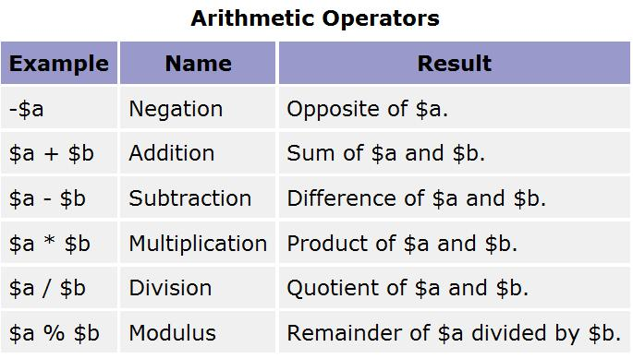
Operators

Slide 10
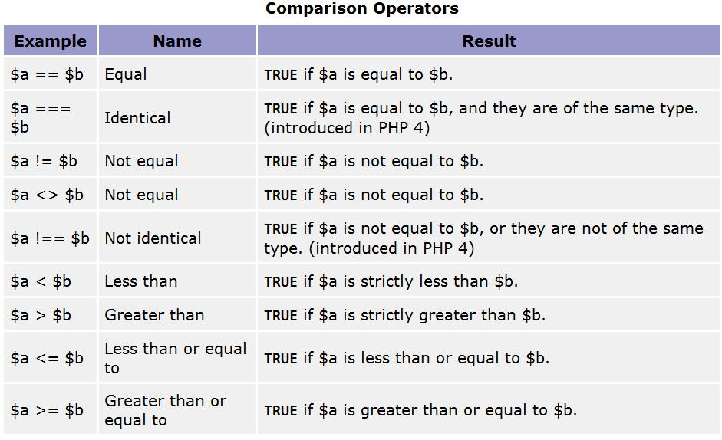
Operators cont…

Slide 11
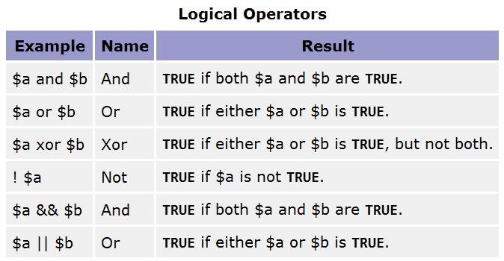
Operators cont…

Slide 12
Operators cont…
Assignment Operators
The basic assignment operator is "=".
Example
<?
$a = 3;
$a += 5; // sets $a to 8, as if we had said: $a = $a + 5;
$b = "Hello ";
$b .= "There!"; // sets $b to "Hello There!", just like $b = $b . "There!";
?>

Slide 13
String Operators
There are two string operators:
  The first is the concatenation operator ('.'), which returns the concatenation of its right and left arguments.
  The second is the concatenating assignment operator ('.='), which appends the argument on the right side to the argument on the left side.
<?php
$a = "Hello ";
$b = $a . "World!"; // now $b contains "Hello World!"
$a = "Hello ";
$a .= "World!"; // now $a contains "Hello World!"
?>

Slide 14
Control Structures
if...else statement - use this statement if you want to execute a set of code when a condition is true and another if the condition is not true
elseif statement - is used with the if...else statement to execute a set of code if one of several condition are true
Syntax
if (condition)
code to be executed if condition is true;
else
code to be executed if condition is false;
Or
if (condition)
code to be executed if condition is true;
elseif (condition)
code to be executed if condition is true;
else
code to be executed if condition is false;

Slide 15
Control Structures (Cont… )
Example
<?
$d=date("D");
if ($d=="Fri")
{
echo "Hello!<br />";
echo "Have a nice weekend!";
echo "See you on Monday!";
}
?>

Slide 16
Controls Structures ( Cont … )
The Switch Statement:
  If you want to select one of many blocks of code to be executed, use the Switch statement.
  The switch statement is used to avoid long blocks of if..elseif..else code.
switch (expression) {
case label1:
code to be executed if expression = label1;
break;
case label2:
code to be executed if expression = label2;
break;
default:
code to be executed if expression is different from both label1 and label2;
}

Slide 17
Control Structures (cont..)
Looping
Very often when you write code, you want the same block of code to run a number of times. You can use looping statements in your code to perform this.
In PHP we have the following looping statements:
  while - loops through a block of code if and as long as a specified condition is true
  do...while - loops through a block of code once, and then repeats the loop as long as a special condition is true
  for - loops through a block of code a specified number of times
  foreach - loops through a block of code for each element in an array

Slide 18
Control Structures (cont..)
The while Statement
The while statement will execute a block of code if and as long as a condition is true.
Syntax
while (condition) code to be executed;
Example
<?
$i=0;
while ($i <5) {
echo “Hello World”;
$i++;
}
?>

Slide 19
Control Structures (cont..)
The do...while Statement
The do...while statement will execute a block of code at least once - it then will repeat the loop as long as a condition is true.
Syntax
do {
code to be executed;
} while (condition);
Example
<?
$i=0;
do {
echo “Hello World”;
$i++;
} while ($i <5)
?>

Slide 20
Control Structures (cont..)
The for Statement
The for statement is the most advanced of the loops in PHP.
In it's simplest form, the for statement is used when you know how many times you want to execute a statement or a list of statements.
Syntax
for (init; cond; incr){
code to be executed; }
Example
<?
for ($i=1; $i<=5; $i++)
{
echo "Hello World!<br />";
}
?>

Slide 21
Control Structures (cont..)
The foreach Statement
The foreach statement is used to loop through arrays.
For every loop, the value of the current array element is assigned to $value (and the array pointer is moved by one) - so on the next loop, you'll be looking at the next element.
Syntax
foreach (array as value)
{code to be executed; }
Example
<?
$arr=array("one", "two", "three");
foreach ($arr as $value)
{
echo "Value: " . $value . "<br />";
} ?>

Slide 22
Functions
A function is a block of code that can be executed whenever we need it.
Creating PHP functions:
  All functions start with the word "function()"
  Name the function - It should be possible to understand what the function does by its name. The name can start with a letter or underscore (not a number)
  Add a "{" - The function code starts after the opening curly brace
  Insert the function code
  Add a "}" - The function is finished by a closing curly brace

Slide 23
Example
<html>
<body>
<?
function writeMyName()
{
echo "Kai Jim Refsnes";
}
writeMyName();
?>
</body>
</html>

Slide 24
PHP Array Functions
PHP Array Introduction
The array functions allow you to manipulate arrays.
PHP supports both simple and multi-dimensional arrays. There are also specific functions for populating arrays from database queries.

Slide 25
PHP array( )
array() creates an array, with keys and values. If you skip the keys when you specify an array, an integer key is generated, starting at 0 and increases by 1 for each value.
Example
<?
$a=array("a"=>"Dog","b"=>"Cat","c"=>"Horse");
?>
<?
$a=array("Dog","Cat","Horse");
?>

Slide 26
PHP array_key_exists ( )
The array_key_exists() function checks an array for a specified key, and returns true if the key exists and false is the key does not exist.
Example
<?
$a=array("a"=>"Dog","b"=>"Cat","c"=>"Horse");
If (array_key_exists("a",$a))
{
echo "Key exists!";
}
else
{
echo "Key does not exist!";
}
?>

Slide 27
PHP array_keys ( )
The array_keys() function returns an array containing the keys.
Example
<?
$cart [0] = “Joe”; $cart [1] = “Peter”; $cart [2] = “Alex”;
foreach(array_keys($cart) as $value)
{
echo $value." = ".$cart[$value]."<br/>";
}
?>

Slide 28
PHP count()
The count() function counts the elements of an array, or the properties of an object.
Example
<?
$people = array("Peter", "Joe", "Glenn", "Cleveland");
$result = count($people);
echo $result;
?>
Output: 4

Slide 29
PHP current ( )
The current() function returns the value of the current element in an array.
Example
<?
$people = array("Peter", "Joe", "Glenn", "Cleveland");
echo current($people) . "<br />";
?>
Output: Peter

Slide 30
PHP next ( )
The next() function moves the internal pointer to, and outputs, the next element in the array.
This function returns the value of the next element in the array on success, or FALSE if there are no more elements.
Example
<?
$people = array("Peter", "Joe", "Glenn", "Cleveland");
echo current($people) . "<br />";
echo next($people);
?>
Output: Peter
Joe

Slide 31
PHP prev ( )
The prev() function moves the internal pointer to, and outputs, the previous element in the array.
This function returns the value of the previous element in the array on success, or FALSE if there are no more elements.
Example
<?
$people = array("Peter", "Joe", "Glenn", "Cleveland");
echo current($people) . "<br />";
echo next($people);
echo prev($people);
?>
Output: Peter
Joe
Peter

Slide 32
PHP Array example
<?
$cart [] = “Joe”; $cart [] = “Peter”; $cart [] = “Alex”;
for( $i=0;$i< count($cart);$i++)
{
echo current($cart)."<br/>";
next($cart);
}
?>

